Slide 1
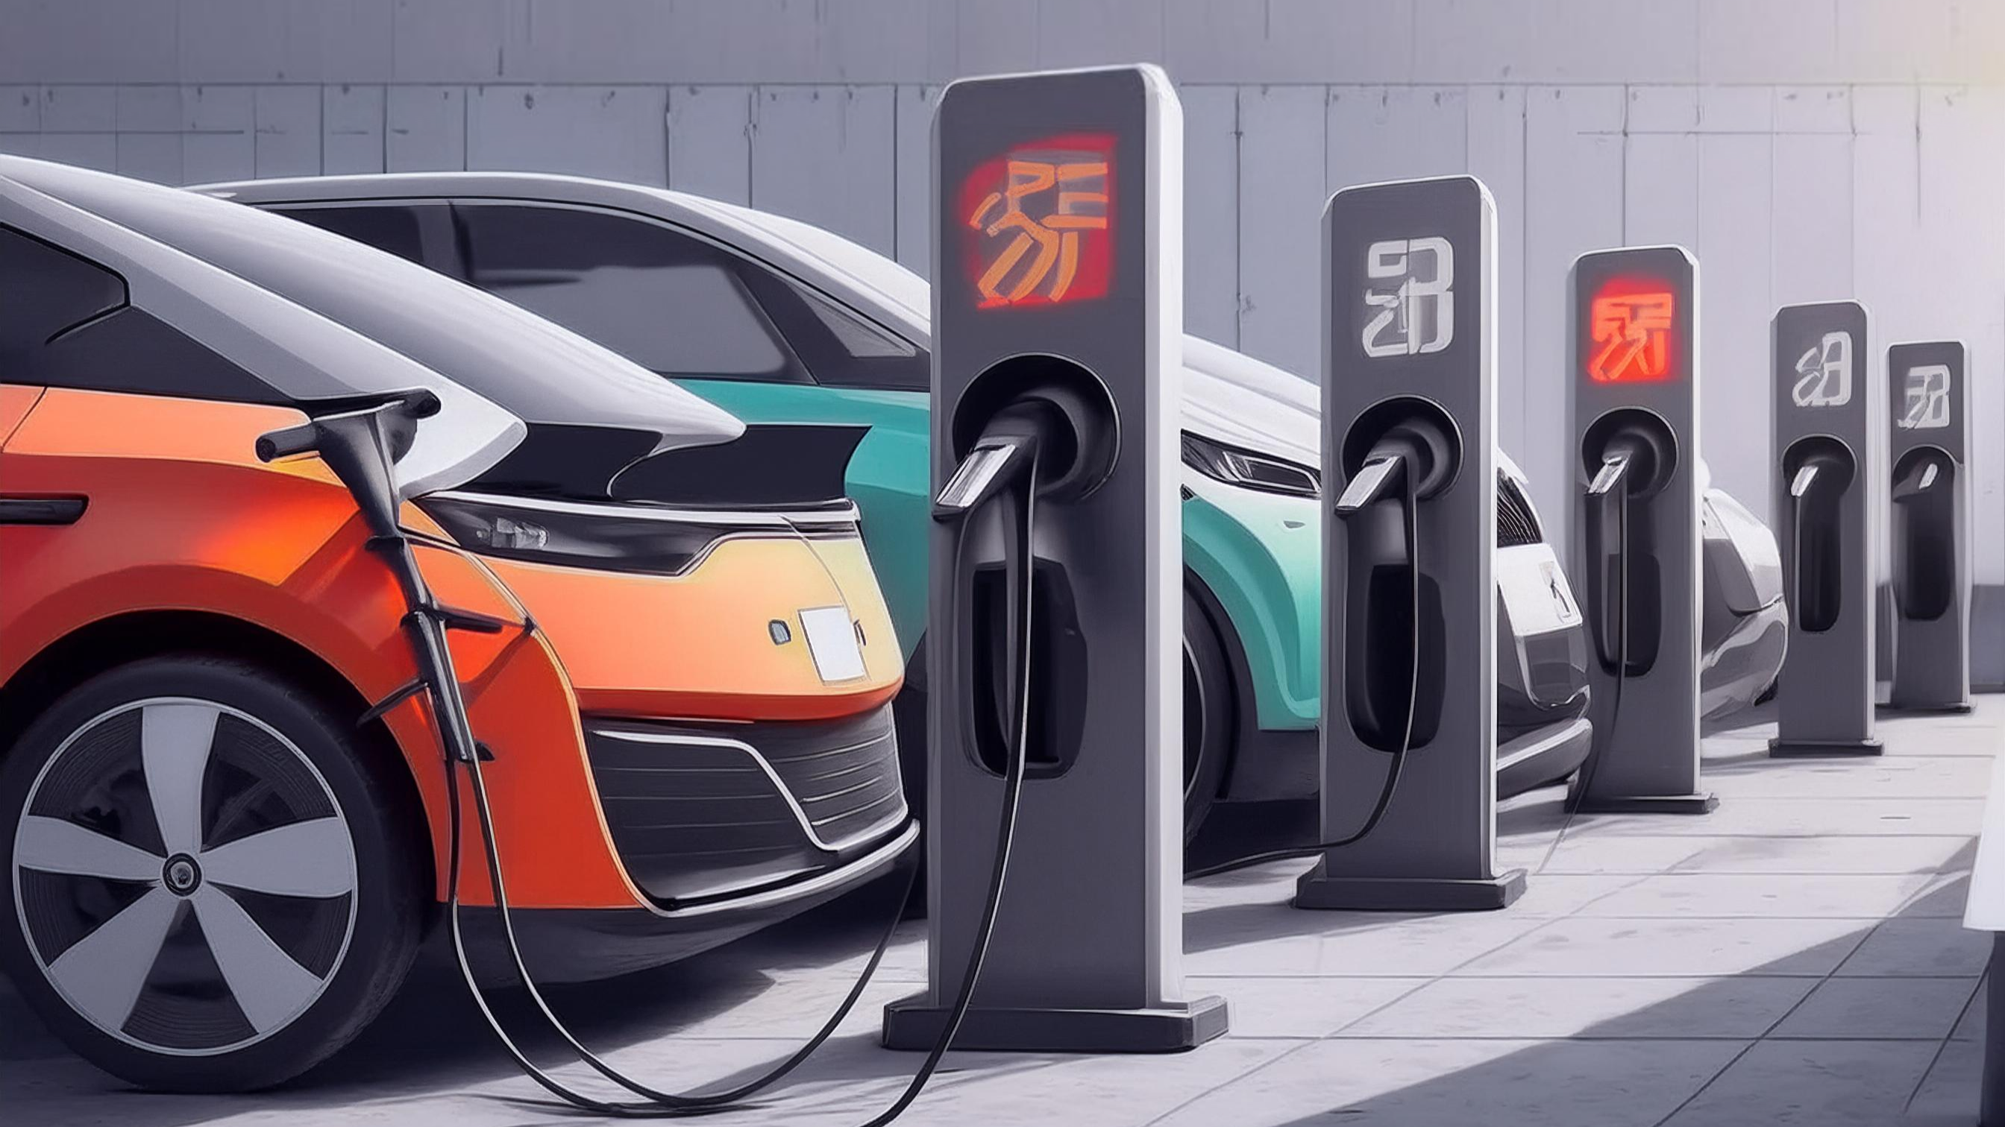
Secondary Research Questions:
What are the primary reasons for customers choosing 4-wheeler EVs in 2023 and 2024 (cost savings, environmental concerns, government incentives)?
Reason Category | Specific Factors | Explanation
Cost Savings | Lower Ownership Costs | Includes reduced fuel, maintenance, and overall expenses.
 | Government Incentives | Tax credits and rebates lower the upfront cost of EVs.
 | Resale Value | Increasing demand improves resale value, making EVs a more attractive investment.
Environmental Concerns | Carbon Footprint Reduction | EVs produce zero emissions, aligning with eco-conscious lifestyles.
 | Air Quality Improvement | Reduces urban air pollution, addressing health concerns.
Government Incentives | Financial Incentives | Includes tax credits, rebates, and other financial benefits.
 | Regulatory Push | Stricter emissions standards and future ICE bans encourage EV adoption.
 | Infrastructure Support | Expanded charging networks reduce range anxiety and support ownership.

Slide 2
How do government incentives and subsidies impact the adoption rates of 2-wheelers and 4-wheelers? Which states in India provided most subsidies?
Impact of Government Incentives and Subsidies on EV Adoption Rates
Influence on Adoption Rates:
Cost Reduction: Subsidies and tax rebates lower the upfront cost of EVs, making them more affordable and boosting adoption.
Market Growth: Incentives encourage consumers to switch from traditional vehicles, with a significant impact on the 2-wheeler market.
Infrastructure Development: Support for charging infrastructure reduces range anxiety, particularly important for 4-wheeler adoption.
Consumer Behavior: Incentives can influence purchase decisions, especially for 4-wheelers where the investment is higher.
Adoption Rates by Vehicle Type:
2-Wheelers: High adoption due to affordability and urban commuting needs.
4-Wheelers: Growing adoption, driven by cost savings and environmental concerns.
Key States in India Providing Subsidies
Delhi: High subsidies for both 2-wheelers and 4-wheelers, plus road tax and registration fee exemptions.
Maharashtra: Significant subsidies and incentives for charging infrastructure.
Gujarat: Attractive subsidies based on battery capacity, plus reduced electricity tariffs.
Tamil Nadu: Focus on 2-wheeler subsidies and incentives for EV manufacturing.
Karnataka: Early adopter with subsidies and support for infrastructure development.

Slide 3

Who should be the brand ambassador if AtliQ Motors launches their EV/Hybrid vehicles in India and why?
Virat Kohli would be a strong choice as a brand ambassador for AtliQ Motors' EV/Hybrid vehicles. Here’s why:
Massive Following: Virat Kohli is one of the most popular cricketers in India and has a huge fan base. His endorsement could significantly increase the visibility of AtliQ Motors' vehicles.
Youth Appeal: Kohli’s image resonates strongly with younger audiences, who are often more inclined towards innovative and sustainable technologies.
Dynamic Personality: His dynamic and ambitious personality aligns well with the cutting-edge and forward-looking nature of EV/Hybrid vehicles.
Commitment to Health and Fitness: Kohli’s focus on health and fitness can be linked to the environmentally friendly aspect of EVs, promoting a lifestyle that values both personal well-being and sustainability.
Overall, Kohli's widespread appeal, energetic personality, and positive image make him an ideal choice for promoting a modern, innovative product like EV/Hybrid vehicles. Few Brands he already ambassador of Audi, Puma , Wrogn, Myntra, Pears etc.

Slide 4
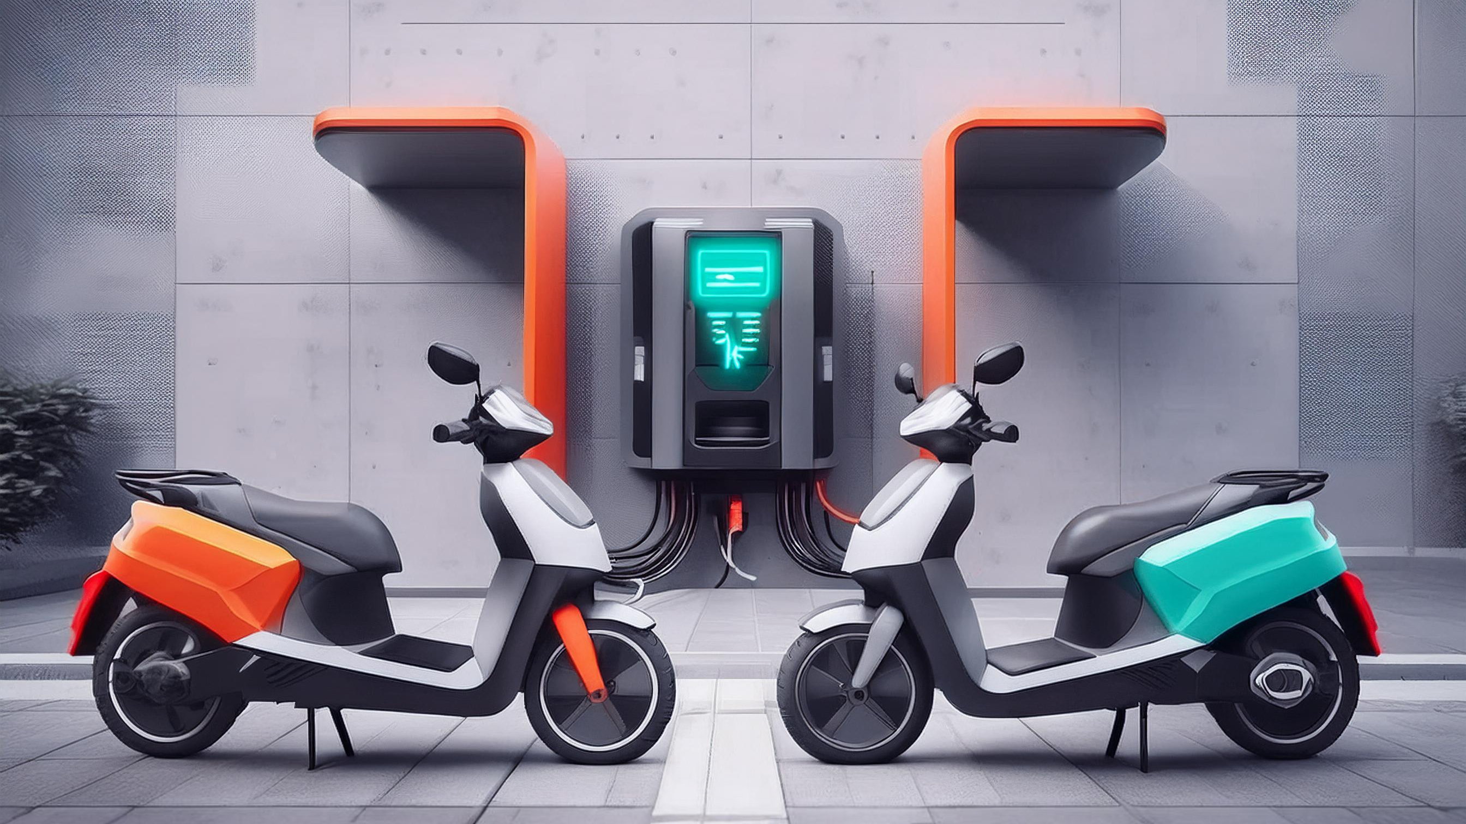
Which state of India is ideal to start the manufacturing unit? (Based on subsidies provided, ease of doing business, stability in governance etc.)
Here are a few states that stand out based on subsidies, ease of doing business, and governance stability:
Gujarat
Maharashtra
Tamil Nadu
Karnataka
Telangana

Slide 5
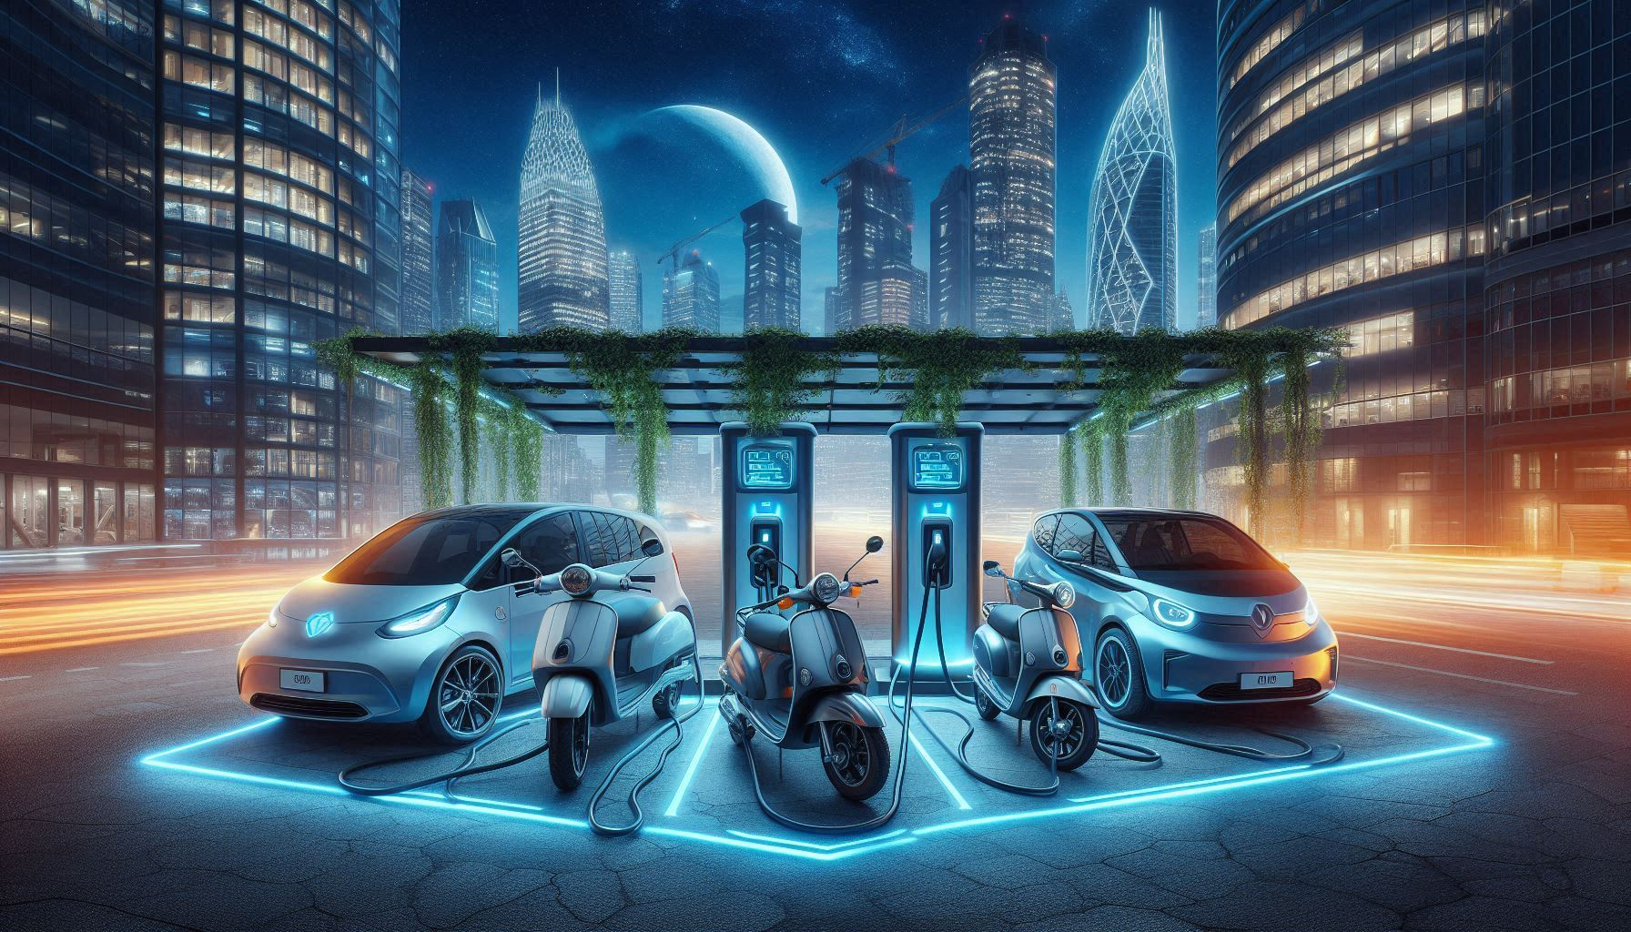
My top 3 recommendations for AtliQ Motors.
For launching a new EV vehicle, AtliQ Motors could consider these top three recommendations:
Innovative Technology Showcase: Highlight the unique technology and features of the EV in your launch. This could include advanced battery life, charging speed, autonomous driving capabilities, and any eco-friendly innovations. Host interactive demonstrations or virtual reality experiences to allow potential customers to engage with the technology firsthand.
Collaborative Partnerships: Partner with tech influencers, automotive journalists, and environmental advocates to create buzz around the launch. Collaborations with established brands or tech companies can also enhance credibility and reach. Consider a launch event that integrates live streaming or virtual participation to engage a global audience.
Sustainability Focus: Emphasize the environmental benefits of the EV, not only in the vehicle’s performance but also in the company’s overall sustainability practices. Share details about how AtliQ Motors is contributing to reducing carbon emissions, using sustainable materials, or supporting green initiatives. This can resonate strongly with eco-conscious consumers and position the brand as a leader in sustainable automotive solutions.

